Slide 1

Employee Engagement
Facing a Connected Future

Slide 2


What is Employee Engagement?
A workplace approach designed to Empower Employees and ensure we are connected and committed to our organization's goals and values.

Slide 3
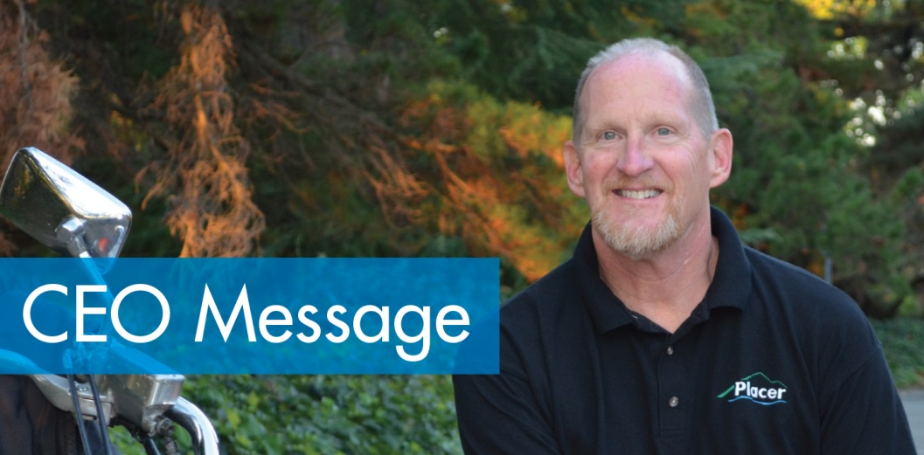
Why is Employee Engagement Important to me and Placer County?
  “Excellent and innovative service delivery relies upon employees that are highly motivated and connected with residents and communities they serve.”
David Boesch

Slide 4
Approaching engagement as a system
Leadership Sponsorship
Communicate
&
Evaluate
Focus Work Teams
Involve Employees

Slide 5

3i Informed Trust Approach

Slide 6






Share the Whys

Slide 7
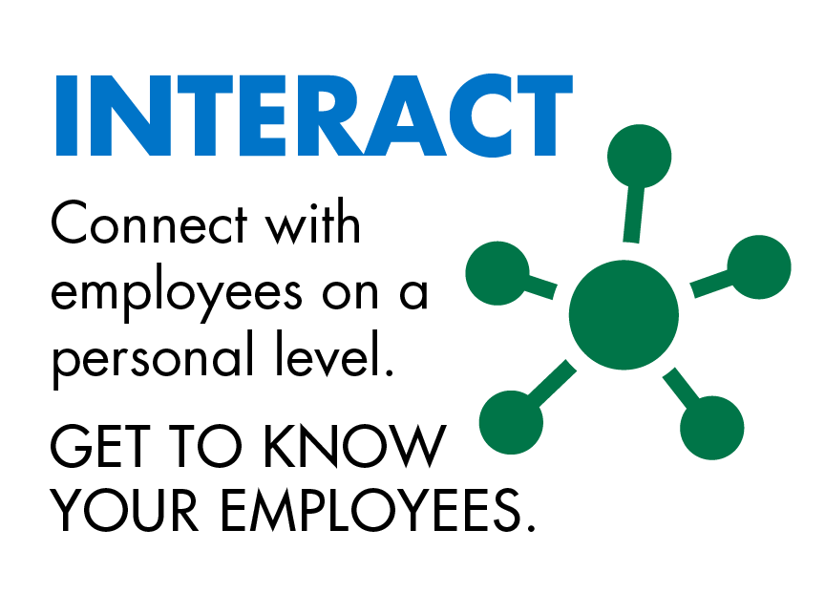






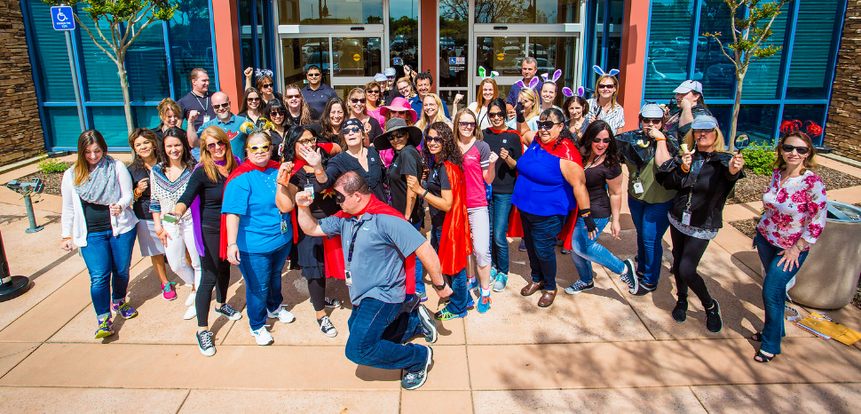

Get to Know Employees

Slide 8
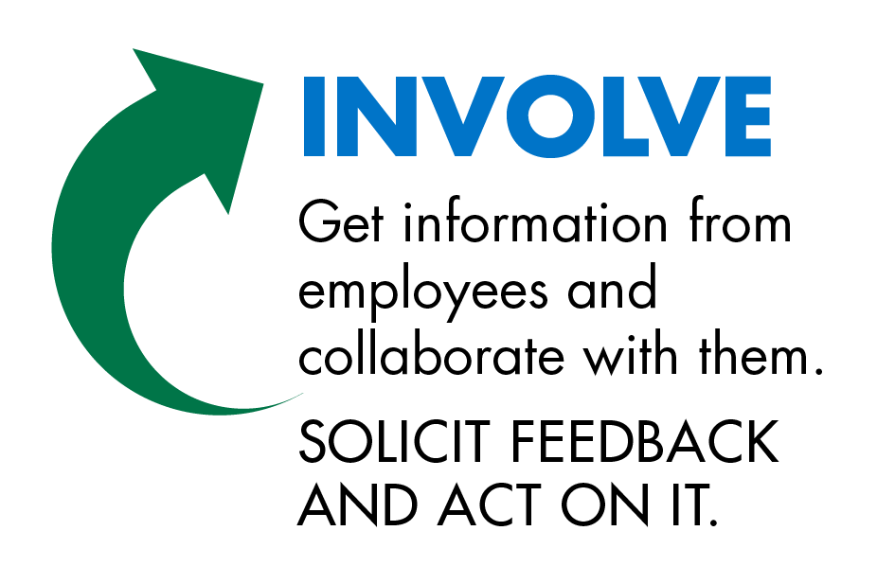



Get Feedback and Act

Slide 9
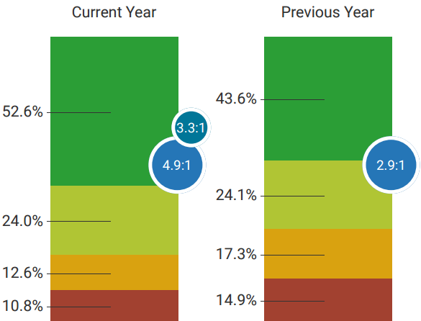
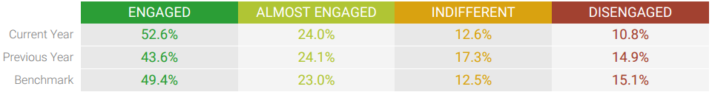
Our Feedback Results

Slide 10
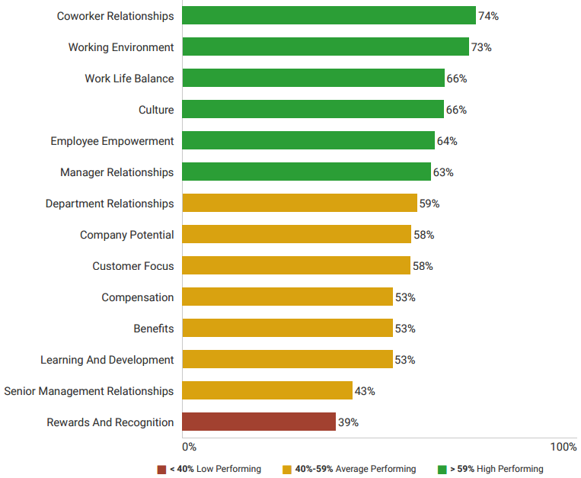

Our Focus
CELEBRATE!
ELEVATE!

Slide 11

Connecting employees to tools

Slide 12
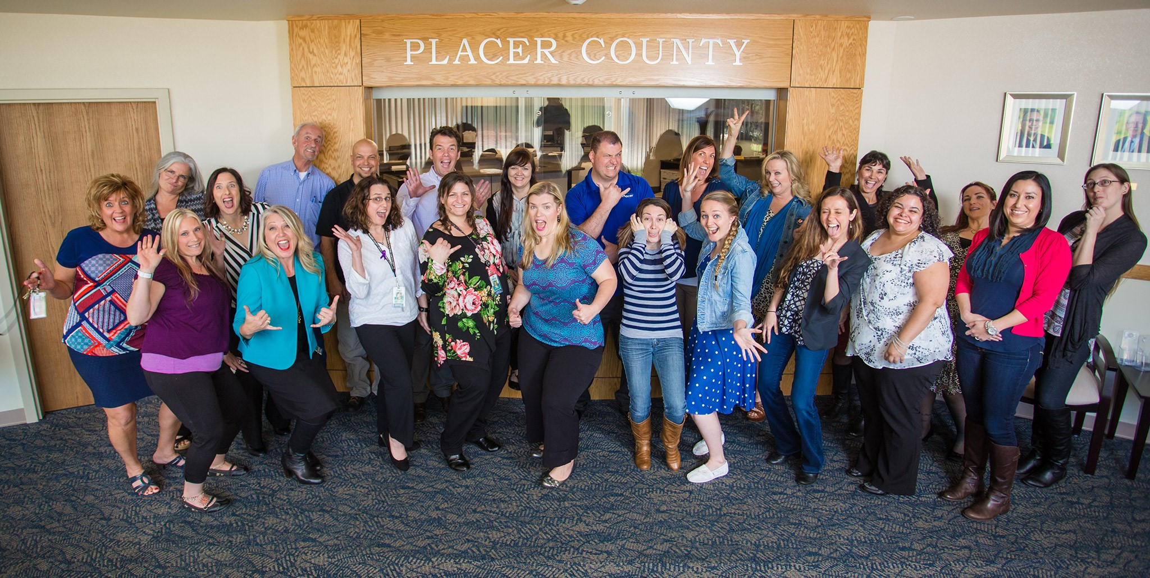
We invite employees to connect and join in!
Join ambassador team
Own your influence
Look within
Follow along
Share your ideas

Slide 13


